Slide 1



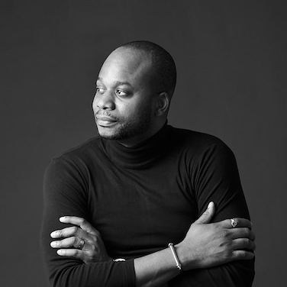
Ade Olufeko – Associate
Professional experience
Education and skills
2 years serving as a management consultant at IBM GBS serving in the public sector of the United States, West Africa, Europe and the Middle East. A responsibility up to project manager and stake holder levels, e.g.
Re-compete e-learning efforts and delivery for the United States Army program and other government classified initiatives, counter intelligence and data analytics leveraging IBM Watson and other IBM enterprise solutions.
Subject matter expert in User and Consumer experience service channels and workflow.
Expert technologist supporting assisting service area managers alongside financial stakeholders.
10 years at Visual Collaborative and The Aveunue Creative LTD, a Creative incubator for technologists and scientists serving brands in the telco, government, commercial and oil and gas industries.
Ade, a product of the dot-com, pursued a non-traditional path of computer science and multimedia at Metropolitan State University in Saint Paul; his field work in humanities launched the international 360 festivals platform Visual Collaborative serving as an executive director.
Ade’s exposure to emerging and frontier markets has given him a contextual intelligent seat as a thought leader to champion breakthrough solutions of widely adopted consumer applications.
Introduction
Ade Olufeko is a pre-eminent thinker, whose fieldwork in humanities influ ences decision-makers in the creative-commerce economy.
Ade is an American trained Technologist (IT), Business Futurist and digital strategist.

